Slide 1

Arrest Data In Los Angeles County 2022-present
By: Jose Barreto, Jose leon, Rodrigo lares ,
Kristopher de la parra, CHRISTIAN garcia

Slide 2
Intro to dataset
The data set that we will be using is based on the City of Los Angeles's arrest incidences from 2021 to the present year. This data was provided by LAPD and as well have been maintained by the LAPD. Some important columns in the data set are location, latitude, longitude, sex code, age, and report ID.

Slide 3
Intro to dataset pt 2.
GitHub URL: https://github.com/CsulaCis3200/ArrestData/settings
Analyzing the dataset has multiple benefits to the residents and law enforcement of Los Angeles.
One, they can identify locations within the city with the most incidents. This can allow people to use alternative and safer routes.
Law enforcement can strategically place patrol cars around areas with high incidents to respond to distress calls quickly.
Understanding offender's age can help create strategies to reform them.

Slide 4

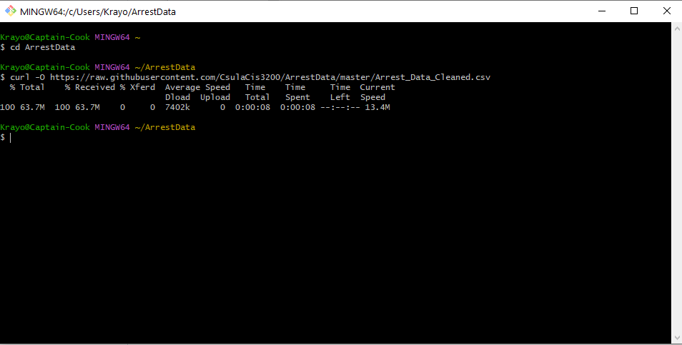
Loading the dataset pt 1.

Slide 5
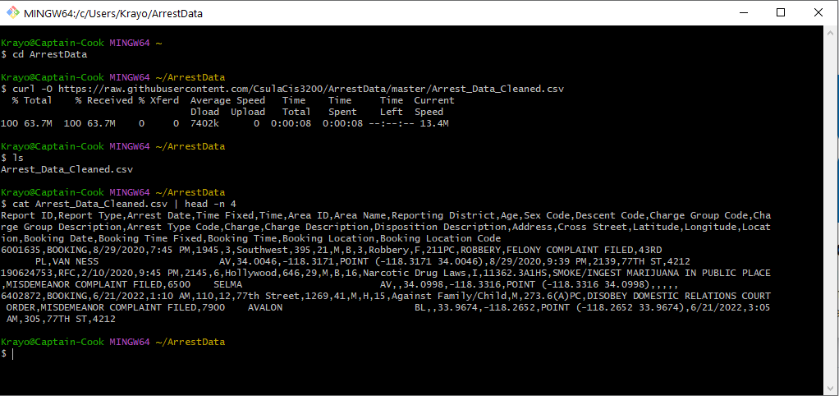
LOADING THE dataset Pt 2.

Slide 6
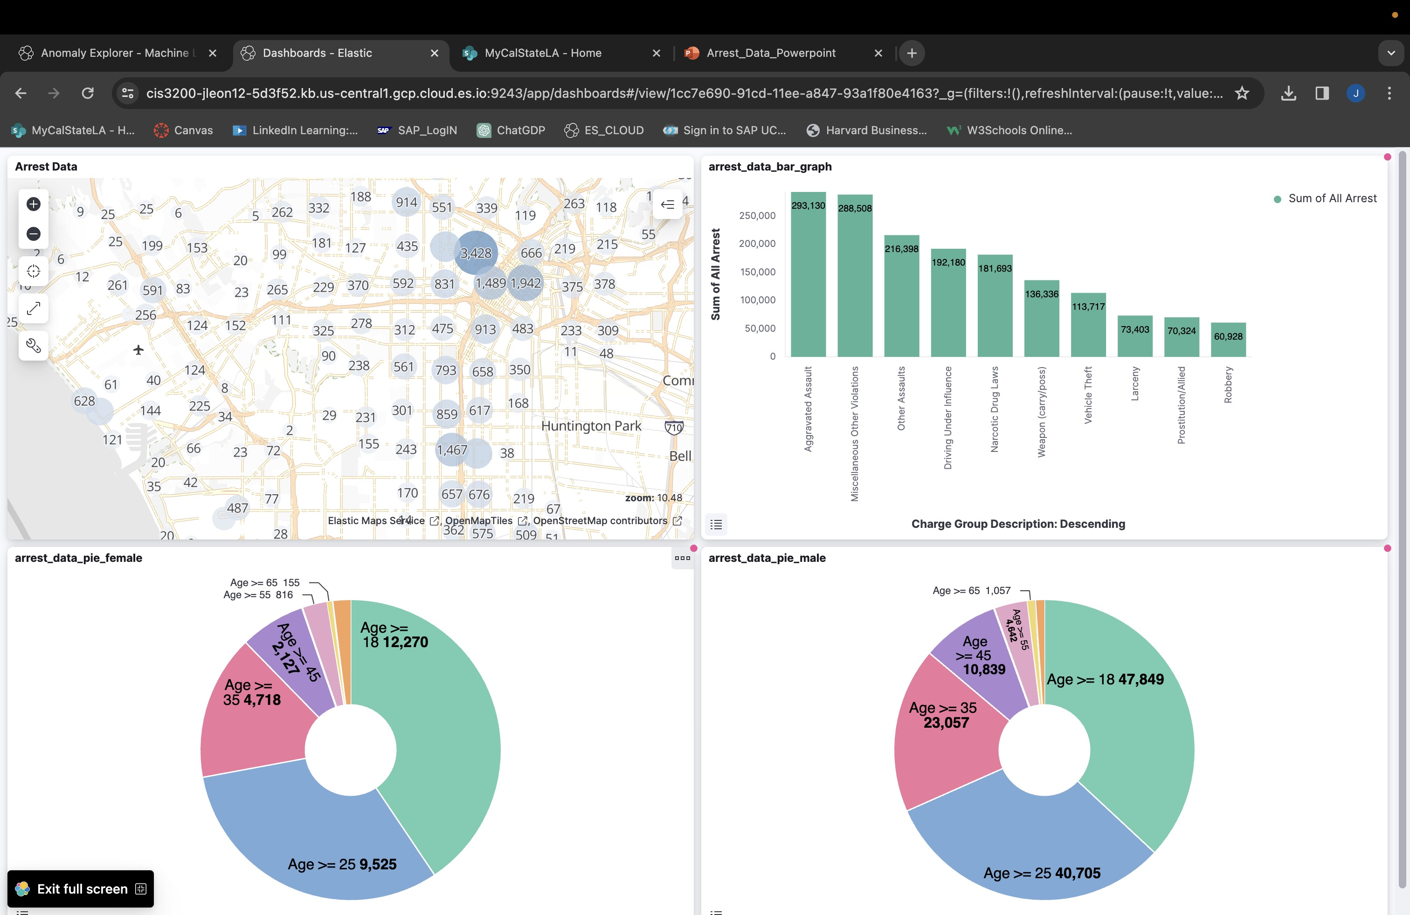
Dashboard
Our data was based on Los Angeles Project with a time frame of January 1, 2022-January 1, 2023

Slide 7
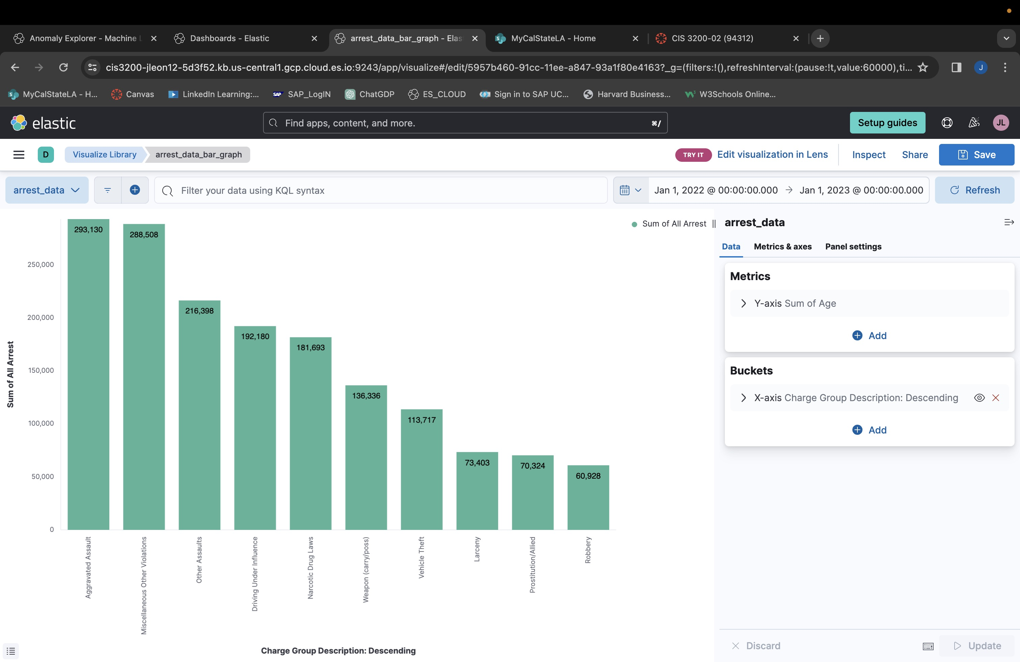
Data Bar Graph
This bar chart was created to showcase the top 10 crimes committed in LA county.
Aggravated Assault and other assault related crimes were top contributors with a high of 293,130

Slide 8
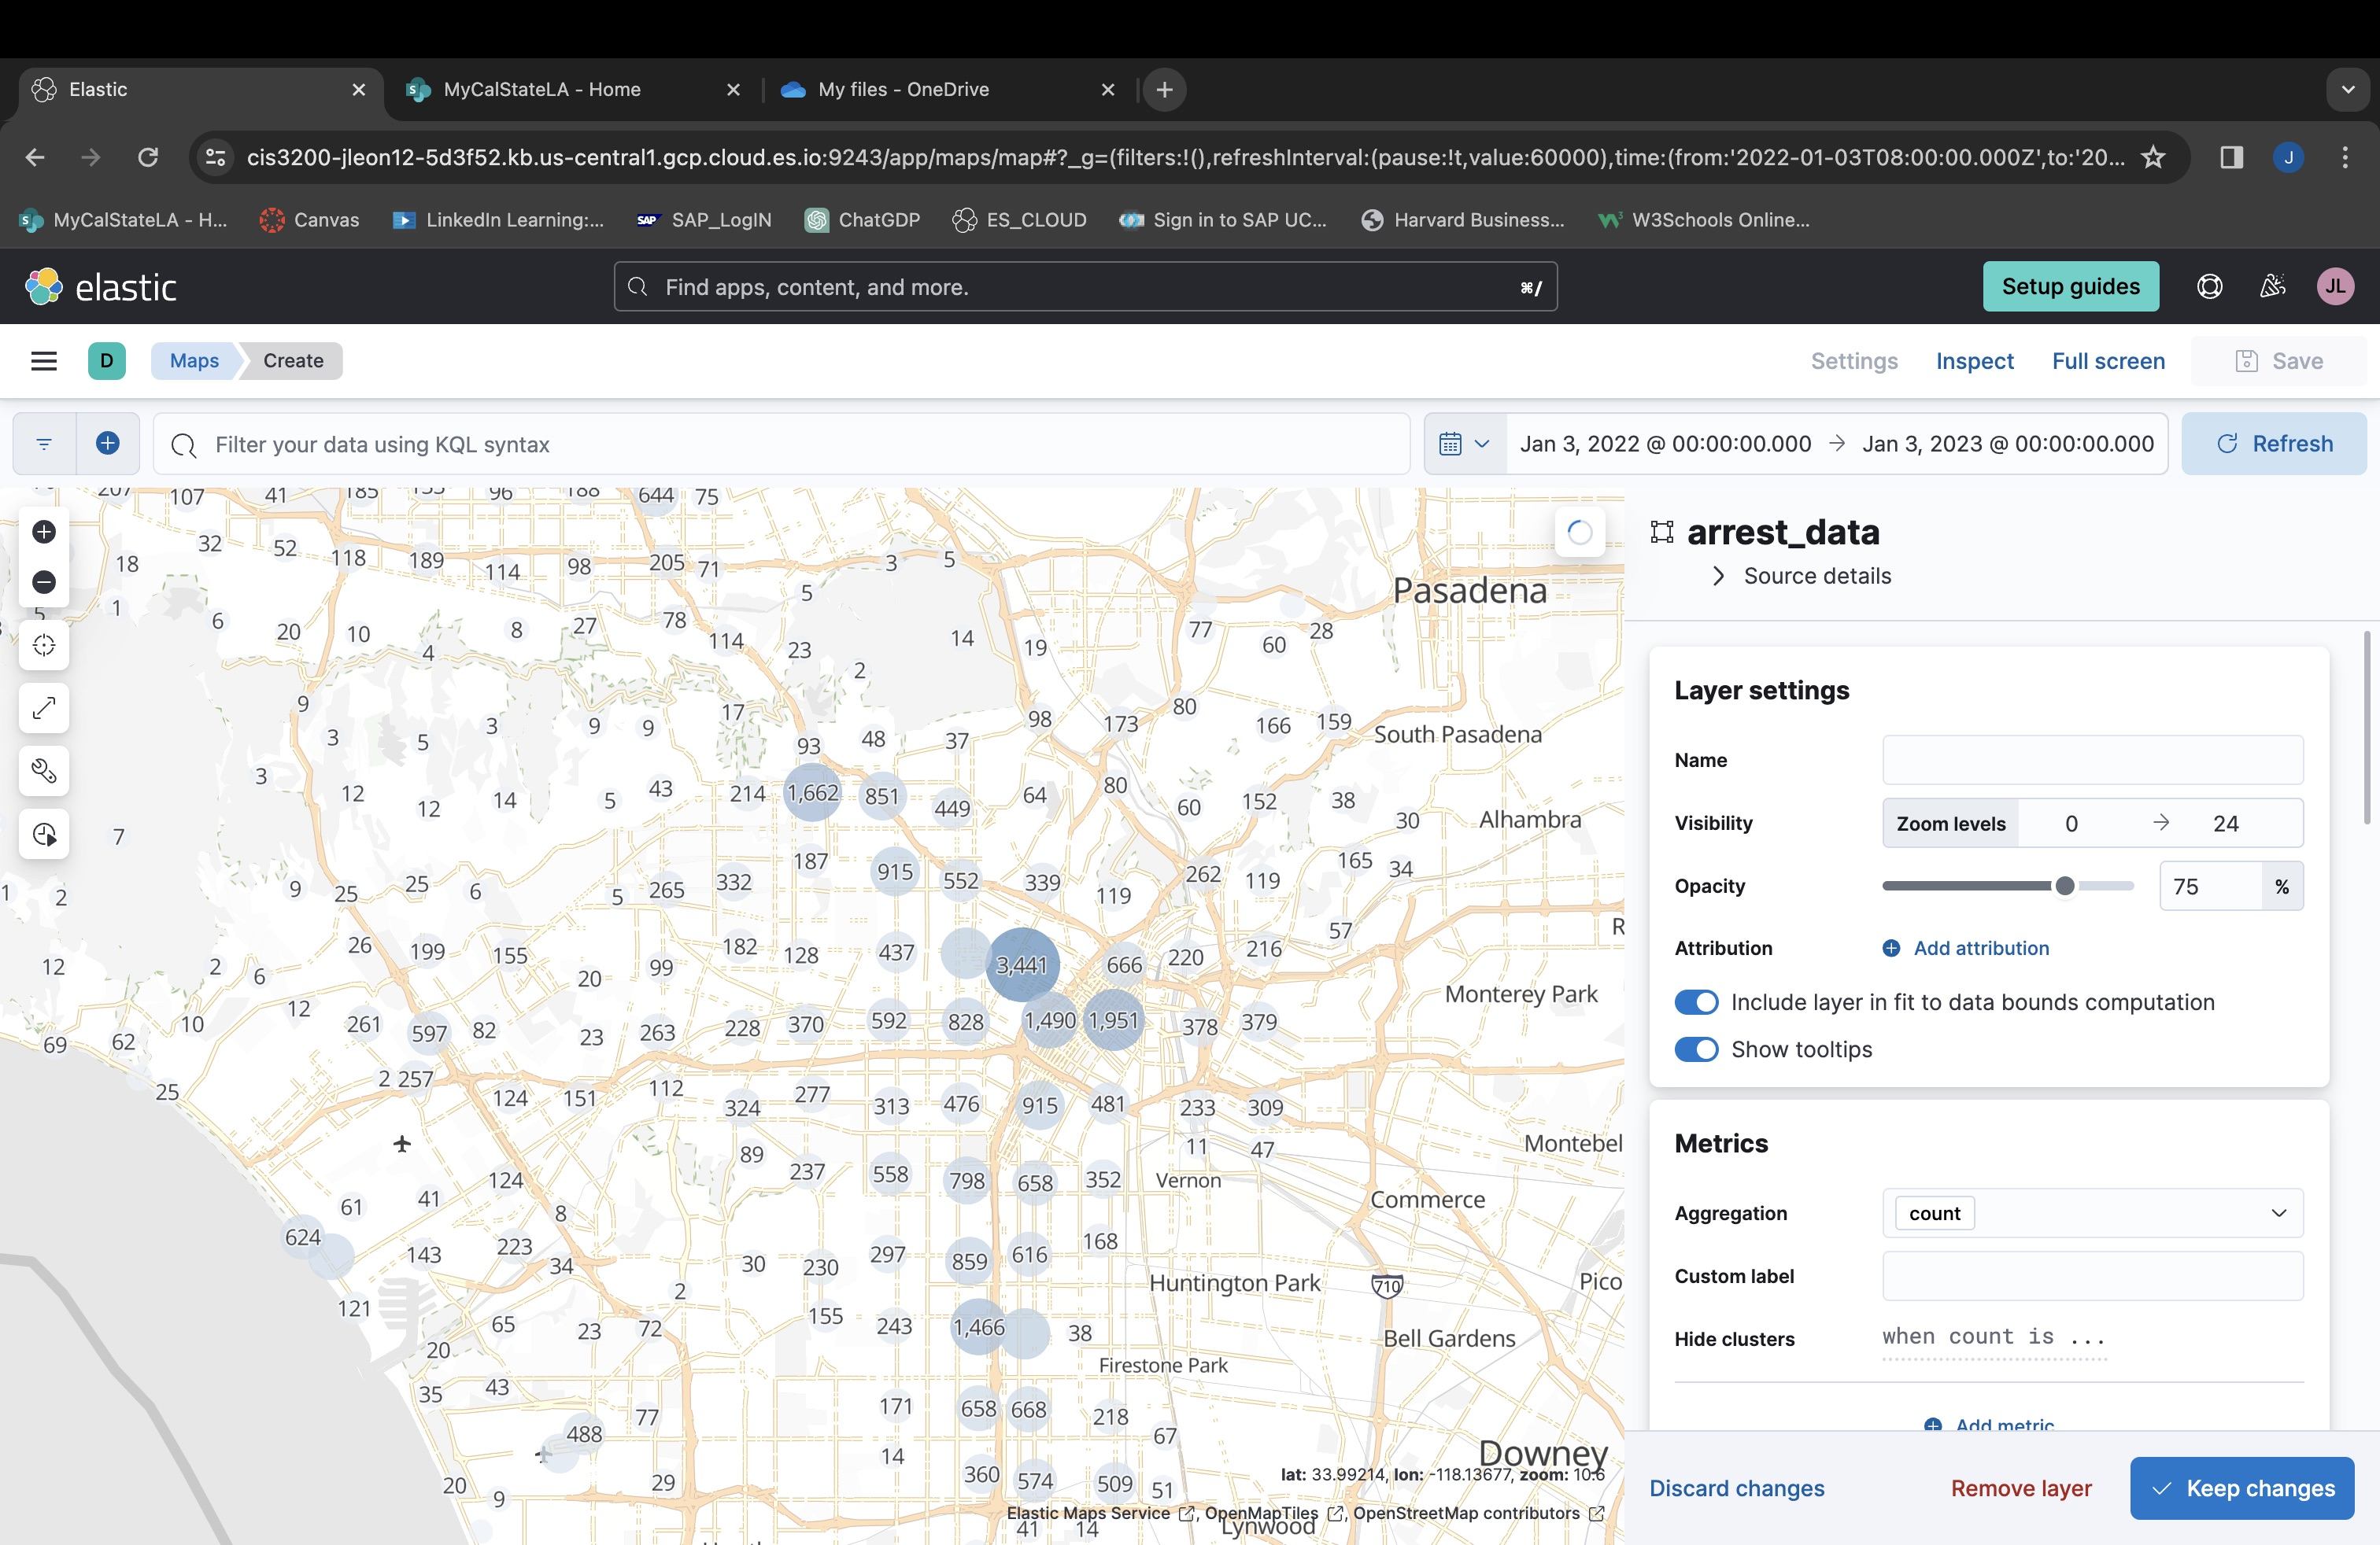
Data analysis pt.1
As shown in this chart we can see the number of arrest per city in LA county. We see that 3,441 is the highest number of arrest in city. We can also see that in certain cities like Downey, Bell Gardens, or Huntington Park there is no records of arrest being made in this dataset.

Slide 9
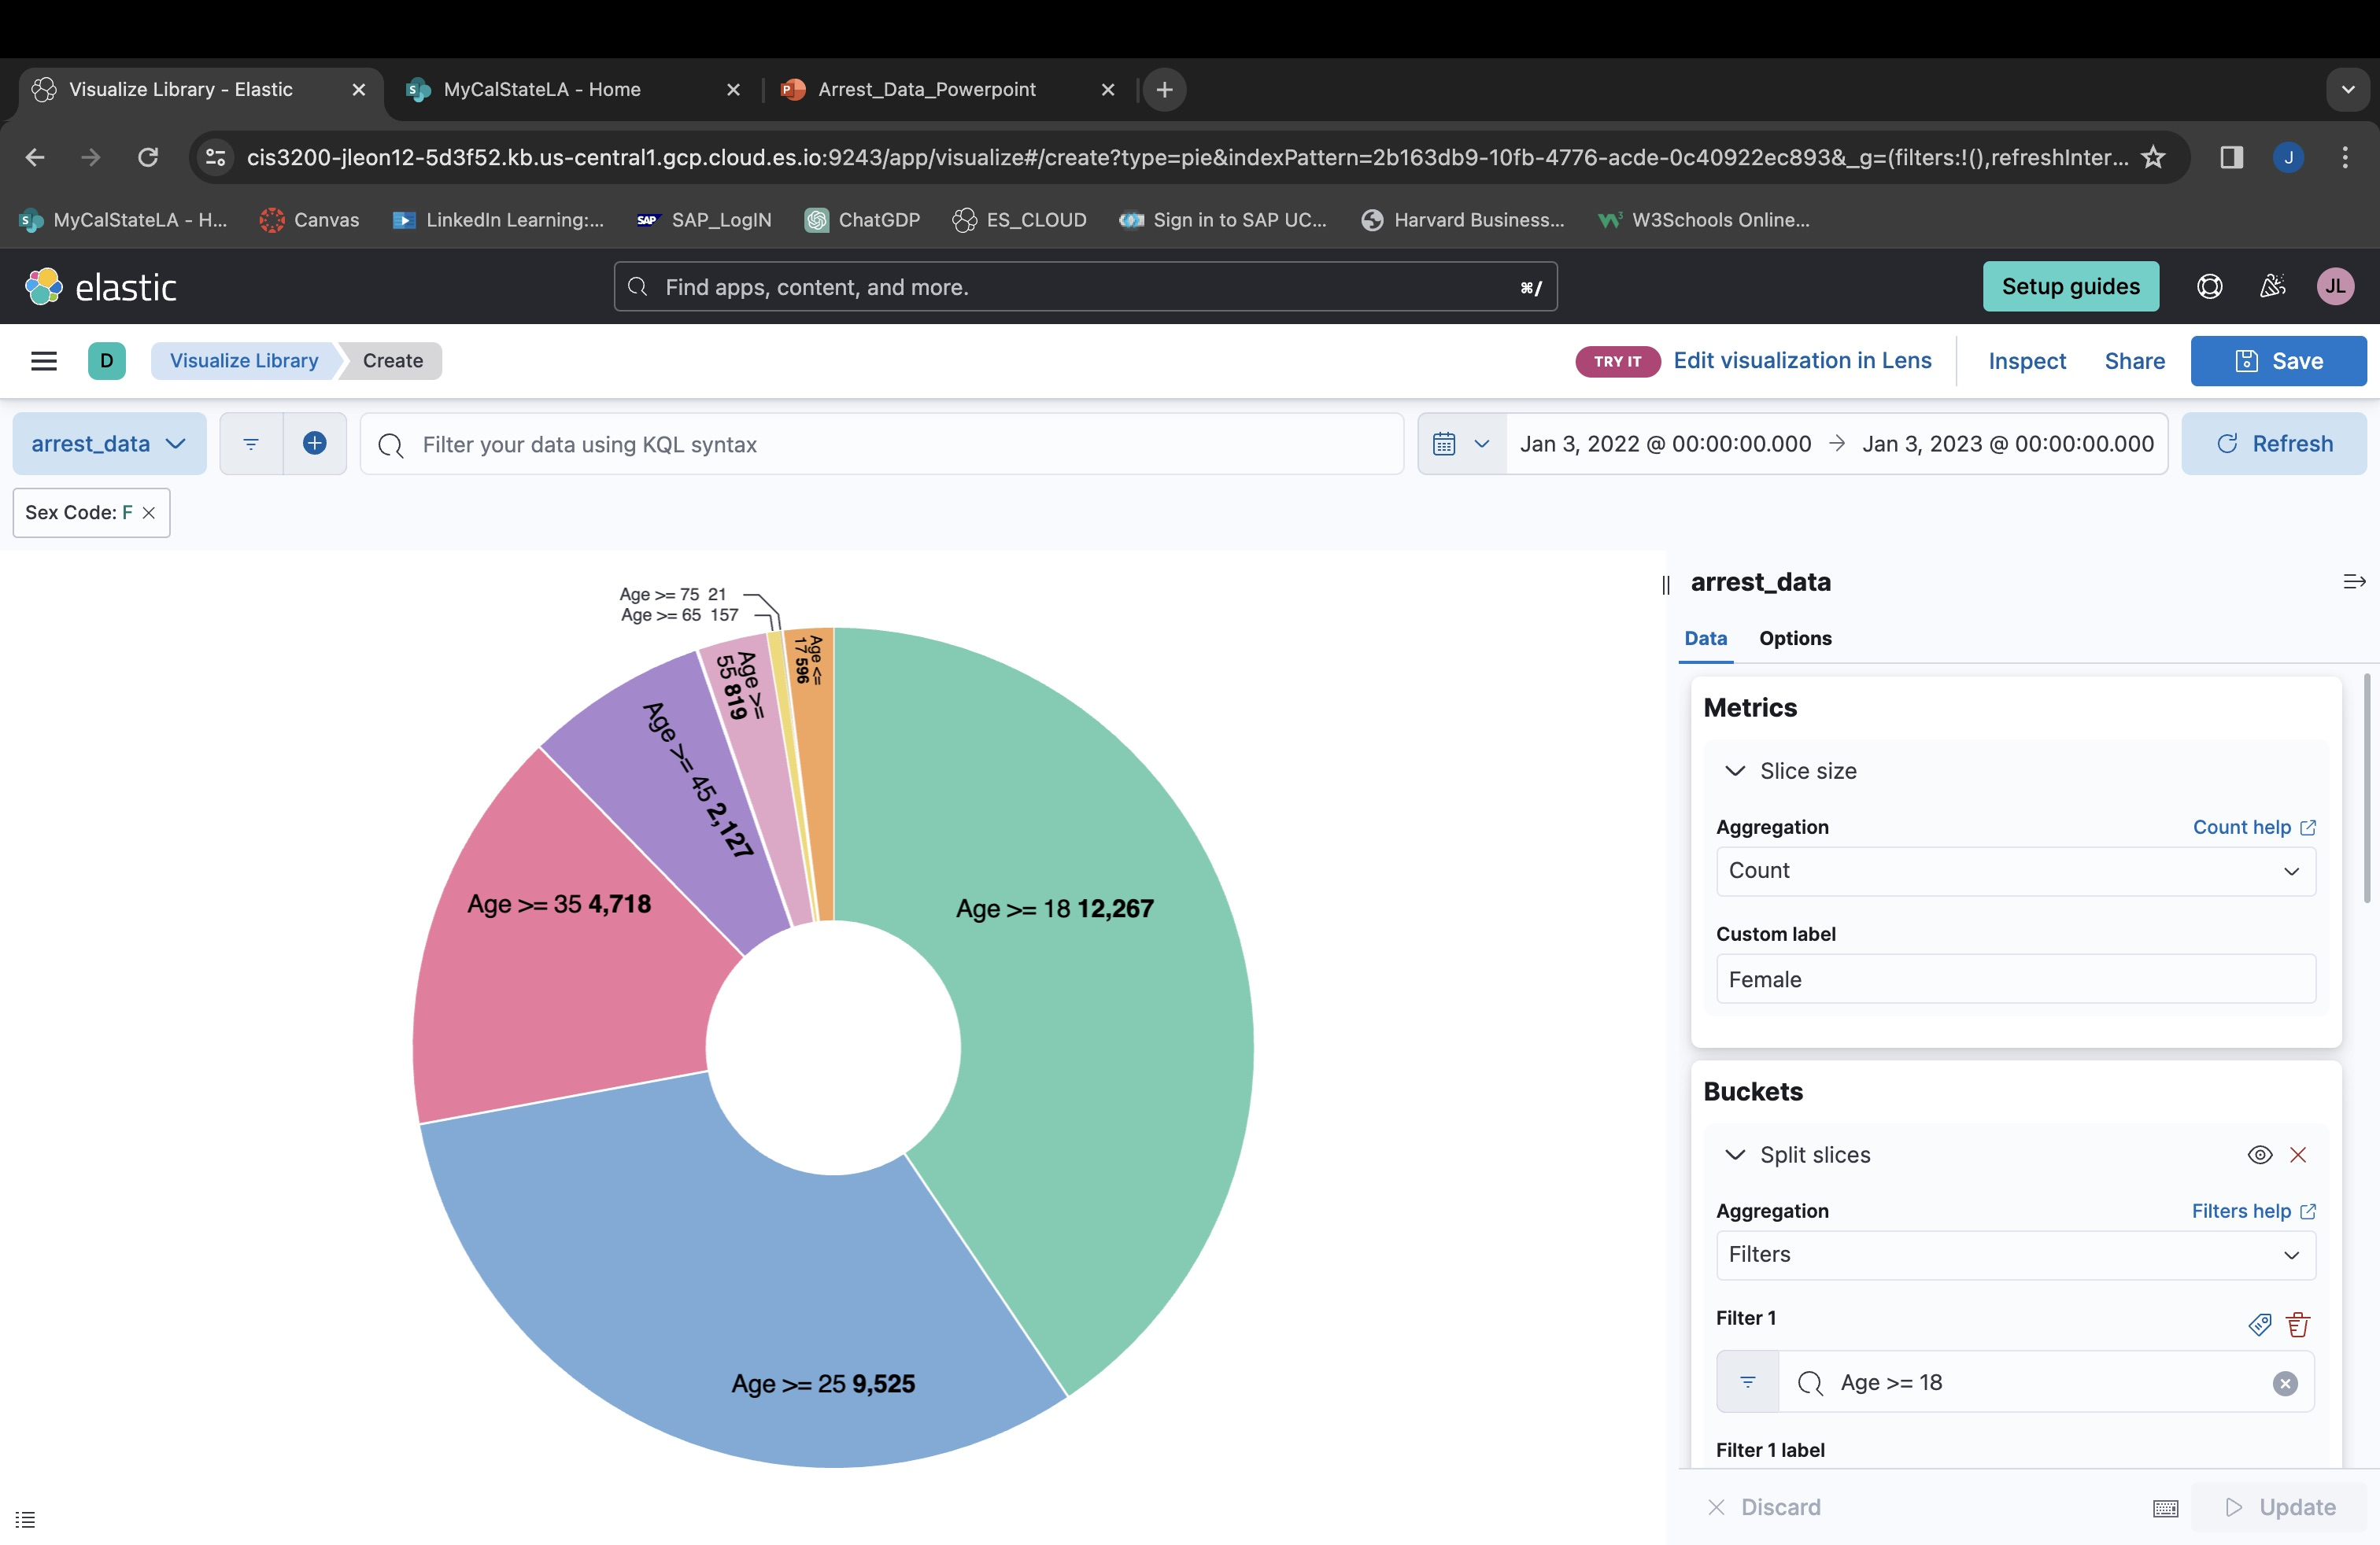
Data analysis pt.2
In this chart we wanted to isolate the female gender and the range of age. This gave us the different age ranges that were committing crimes. We can see that the biggest portion is from the ages of 18 or younger.

Slide 10
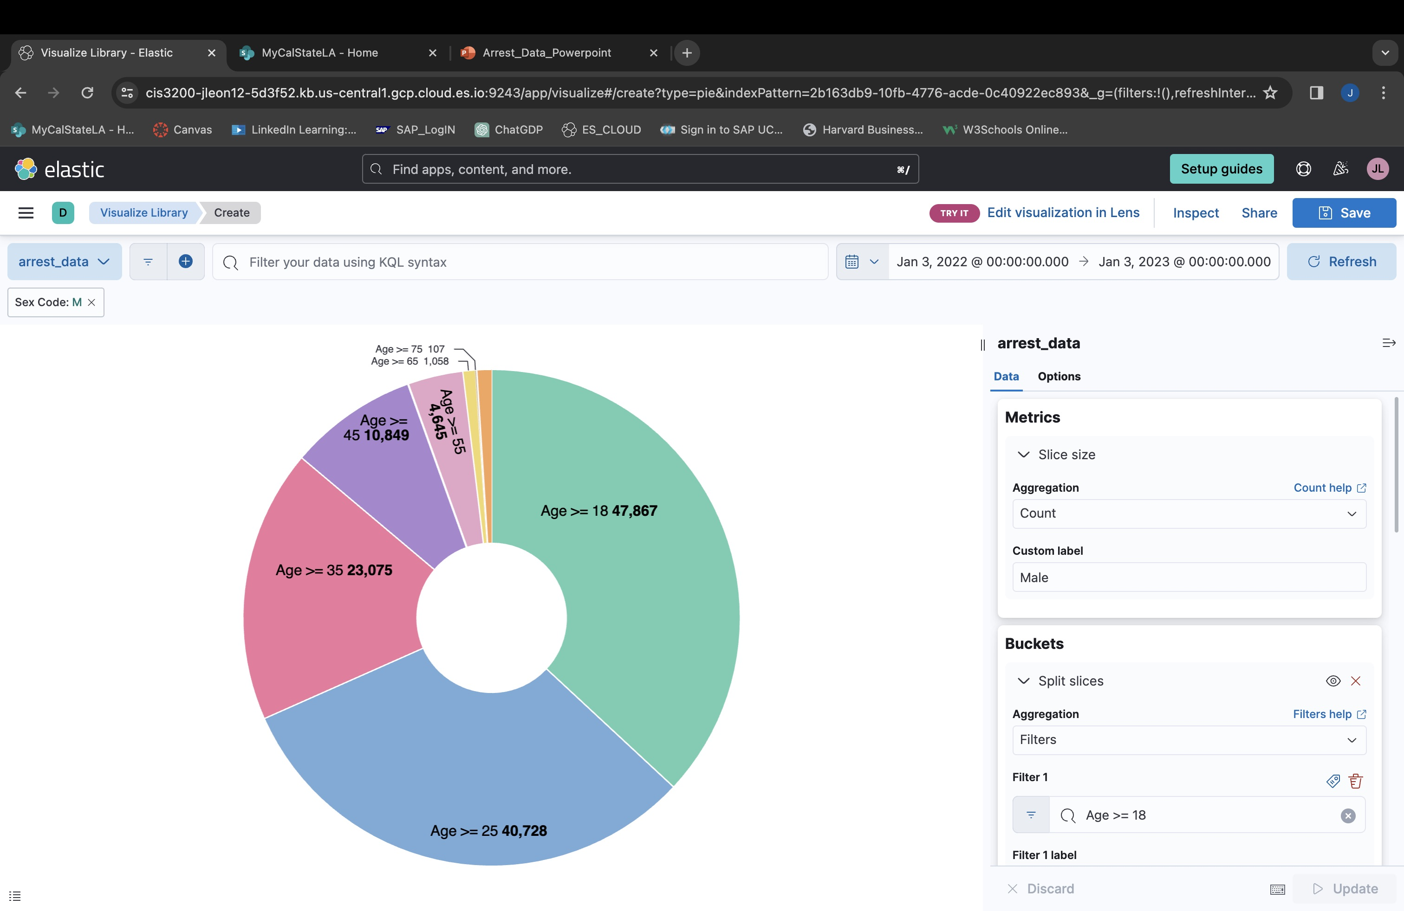
Data analysis pt.3
In our final chart we wanted to see the age range of crimes being committed by males. As we see that biggest portion is ages 18 and younger. We see that there is over 47,000 arrest during that age range.

Slide 11
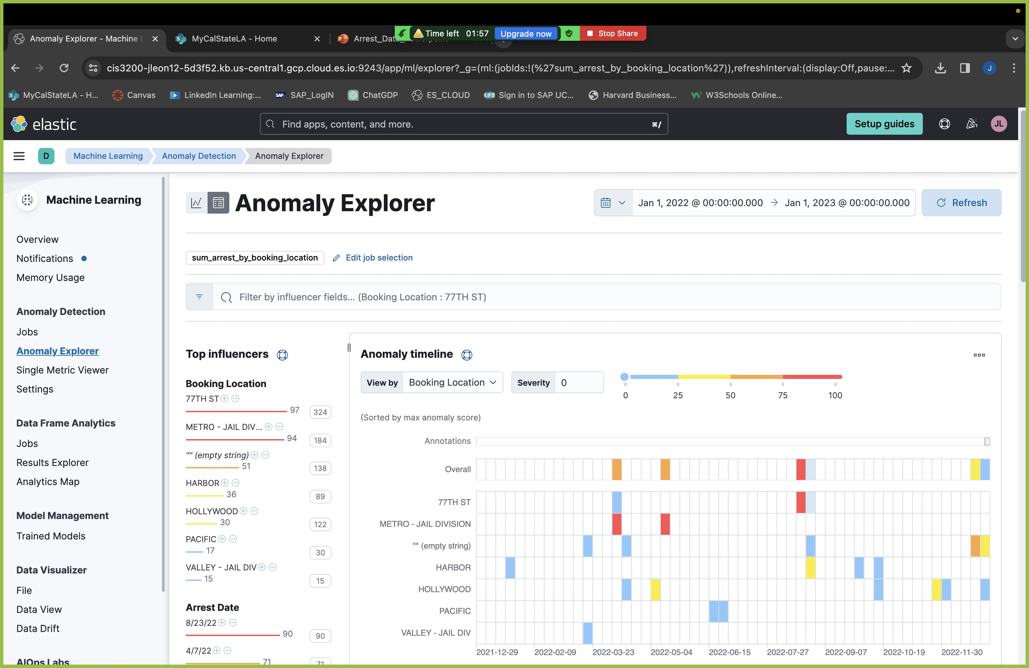
Predictive analysis pt.1
Our predictive analysis was used to take the variables booking location and arrest date to forecast any areas of interest that may experience a higher crime rate.
77th Street was named as a top influencer meaning that the area was predicted to have higher crimes.

Slide 12
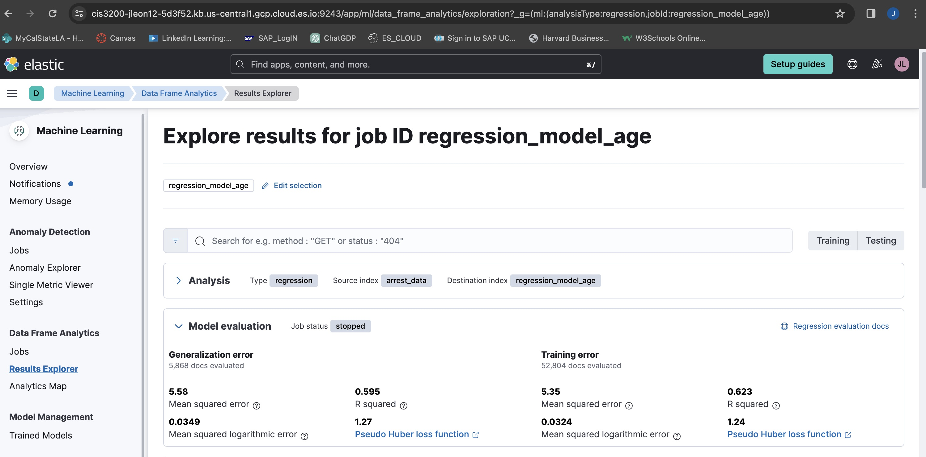
PREDICTIVE ANALYSIS PT.2
Our regression model for the dependent variable of age was closely accurate
We got an MSE of 5.58 which was close to 0 making the model somewhat accurate
Our R squared was 0.595 which shows a moderate relationship

Slide 13
Questions??

